Slide 1


TRANSLATION OF AXIS
Math 14
Plane and Solid Analytic Geometry

Slide 2
Translation of Axes

Slide 3
OBJECTIVES:
At the end of the lesson, the student is expected to be able to:
• translate coordinate axes.
• find new coordinates after translation.
• find new equation if the origin is translated to a given point..
• simplify the equations by translation of axes.
• graph the transformed equation.

Slide 4
Definition: Translation of Axes
Consider a transformation in which the new axes are parallel to the original axes and similarly directed. Translation of axes is related to performing two geometric transformations: a horizontal shift and a vertical shift. Hence the new axes can be obtained by shifting the old axes h units horizontally and k units vertically while keeping their directions unchanged.
Let x and y stand for the coordinates of any point P when referred to the old axes, and x’ and y’ the coordinates of P with respect to the new axes. Then x = x’ + h and y = y’ + k.

Slide 5
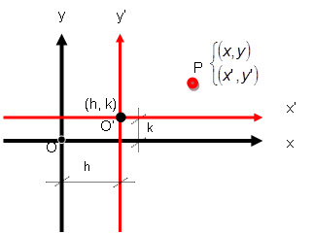
y
x

Slide 6
Examples:
Find the new coordinates of the point P(4,-2) if the origin is moved to (-2, 3) by a translation.
Find the new equation of the circle x²+y²-6x+4y-3=0 after a translation that moves the origin to the point (3,-2).
Translate the axes so that no first-degree term will appear in the transformed equation.
a. x²+y²+6x-10y+12=0
b. 2x²+3y²+10x-18y+26=0
c. x²-6x-6y-15=0

Slide 7
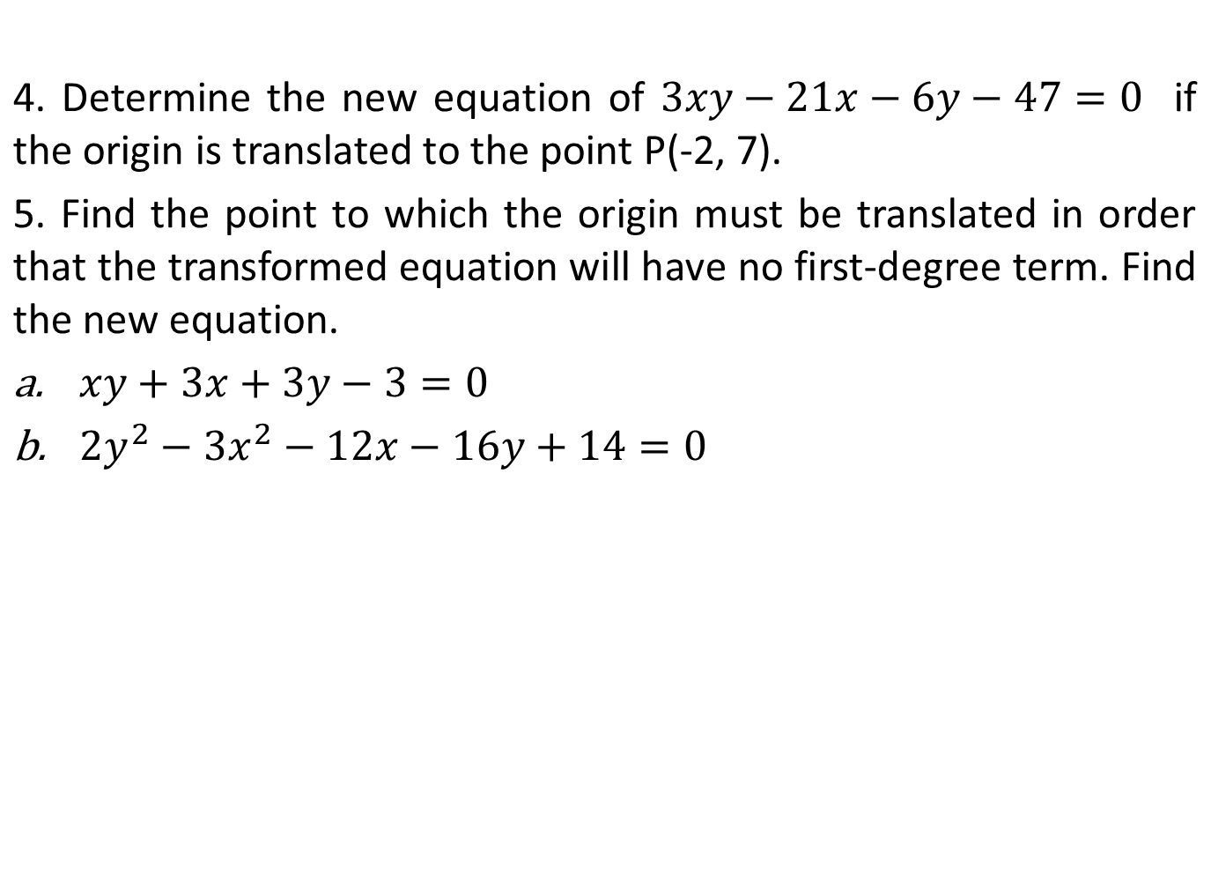
REFERENCES
Analytic Geometry

